Slide 1
CSE 400: Fundamentals Of Probability In Computing
Probabilistic Precipitation Nowcasting

Slide 2
Student Information
NAME | STUDENT ID
Heer Patel | AU2420114
Chaithanya J | AU2440097
Modi jenil | AU2440247
Akshita Muchhal | AU2440081
Nikkesh Parekh | AU2440214

Slide 3
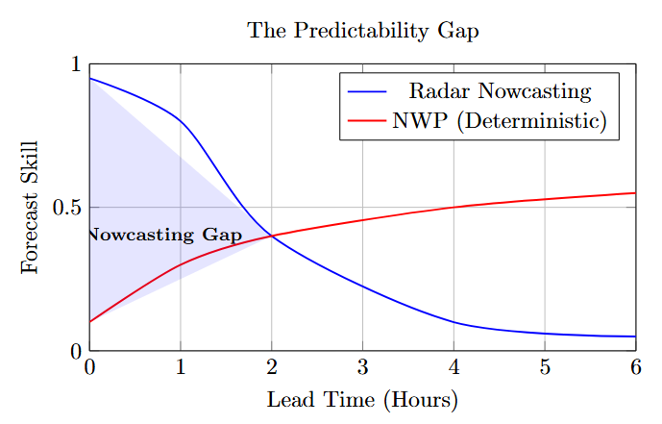
Background and Motivation
The Lead-Time Gap: NWP models are too slow for the 0–2 hour window where flash floods and aviation risks are highest.
Chaotic Dynamics: Rainfall isn't just a moving picture; it involves rapid convective growth and decay that static models ignore.
Operational Need: Demand for high-resolution, real-time systems to support emergency response and urban water management.

Slide 4
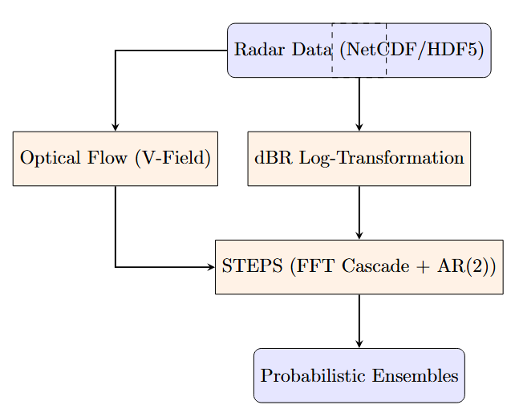
Base paper Overview
The Pysteps Library: Introduced the first open-source, modular framework for probabilistic precipitation nowcasting.
The STEPS Method: Combines Optical Flow (motion) with Multi-scale Cascades (structure) to simulate storm evolution.
Global Validation: Proved consistency across diverse climates, from stratiform rain in Finland to cyclones in Australia.

Slide 5
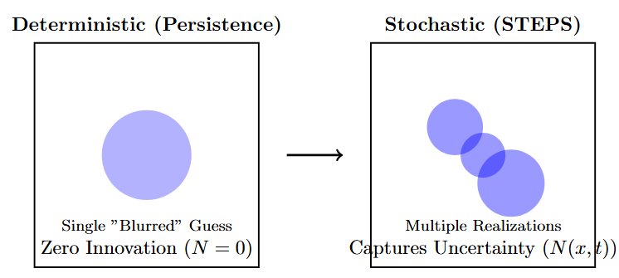
Problem Statement
Predictability Limit: Deterministic forecasts lose physical relevance after ~80 minutes due to the "frozen" motion assumption.
Non-Gaussian Data: Raw rainfall is skewed and intermittent; it requires log-transformation into a latent state for valid math.
Uncertainty Quantification: A single "best guess" cannot capture atmospheric variance; we need Ensembles to measure risk.

Slide 6
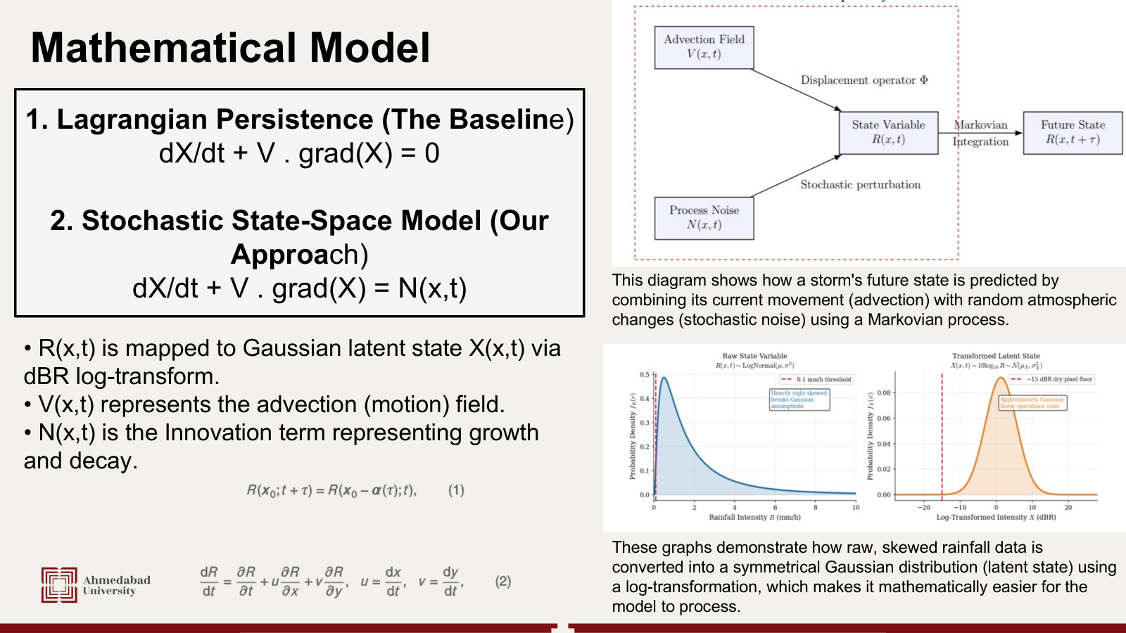


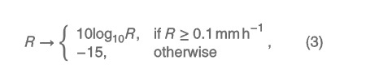

Slide 7
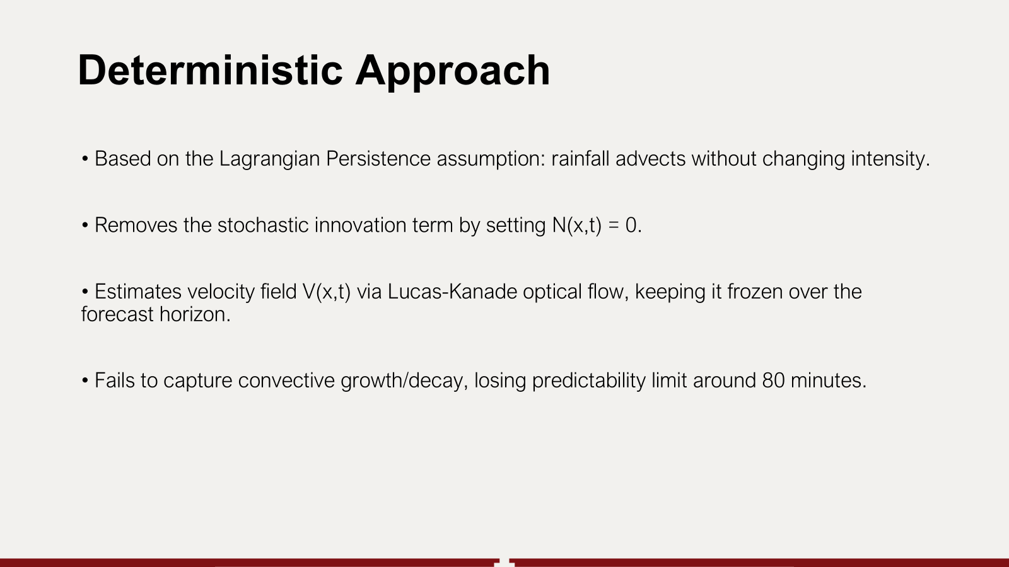

Slide 8
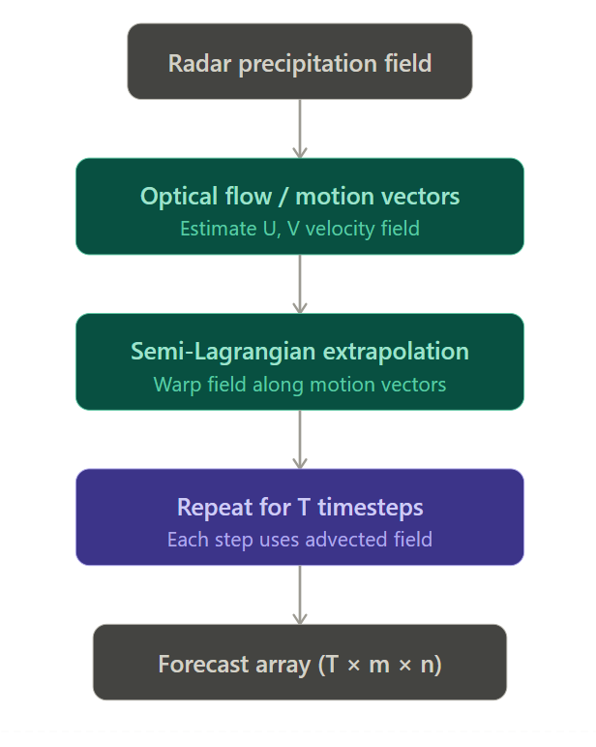
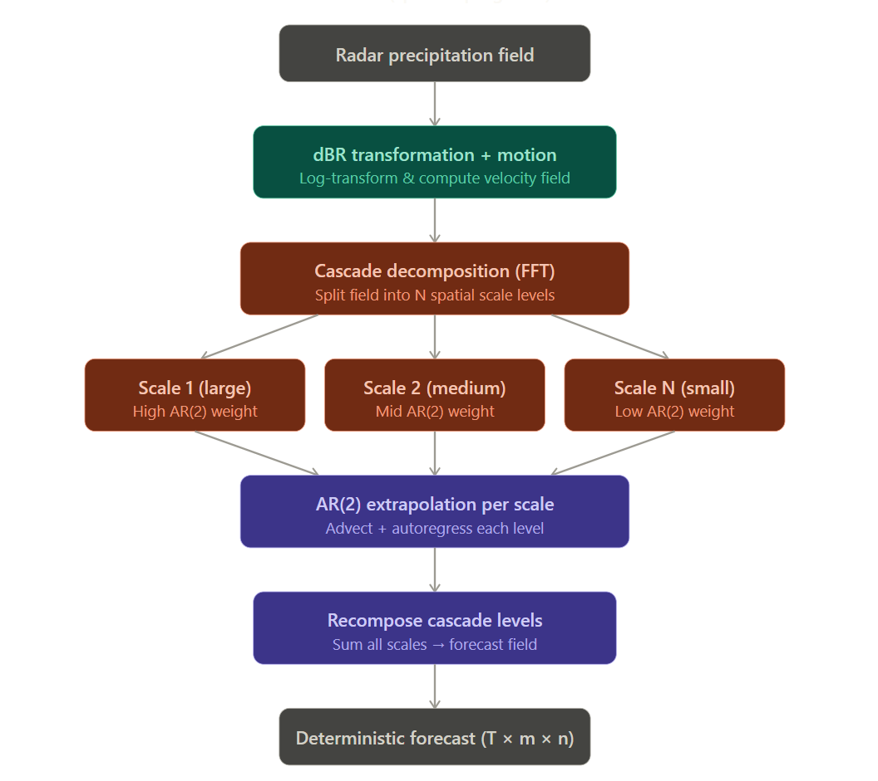
Extrapolation S-PROG

Slide 9
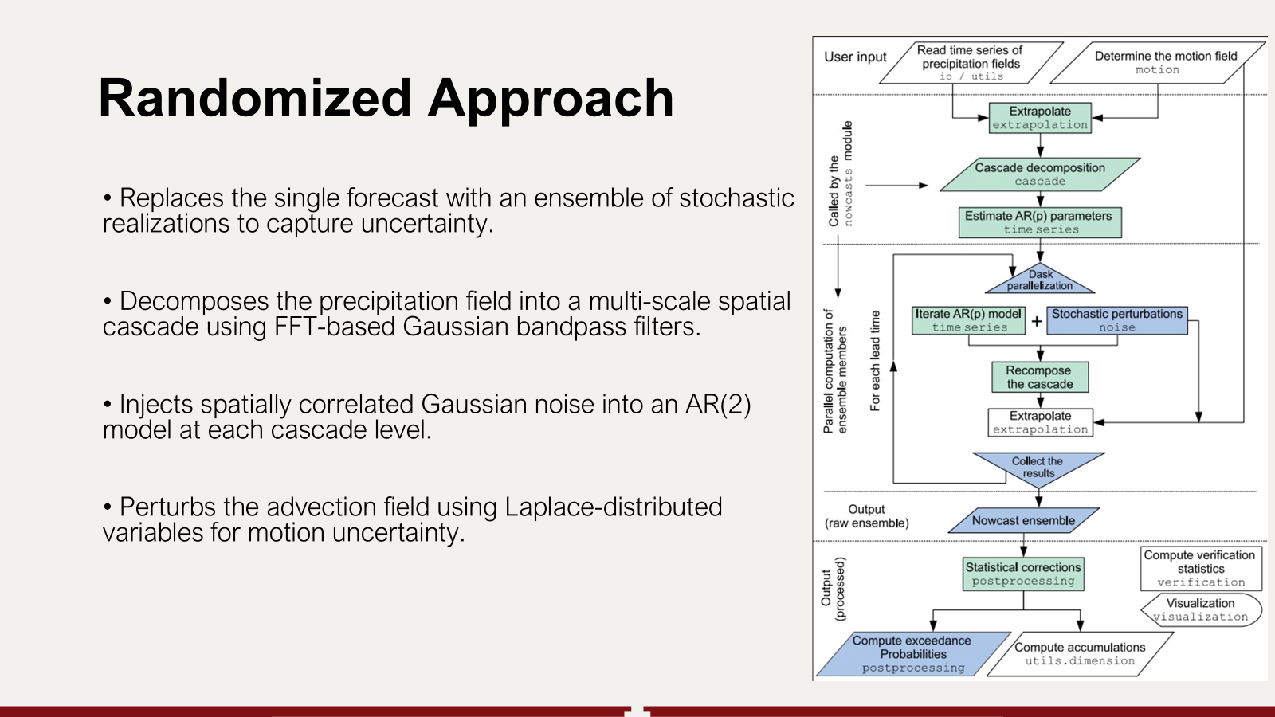

Slide 10
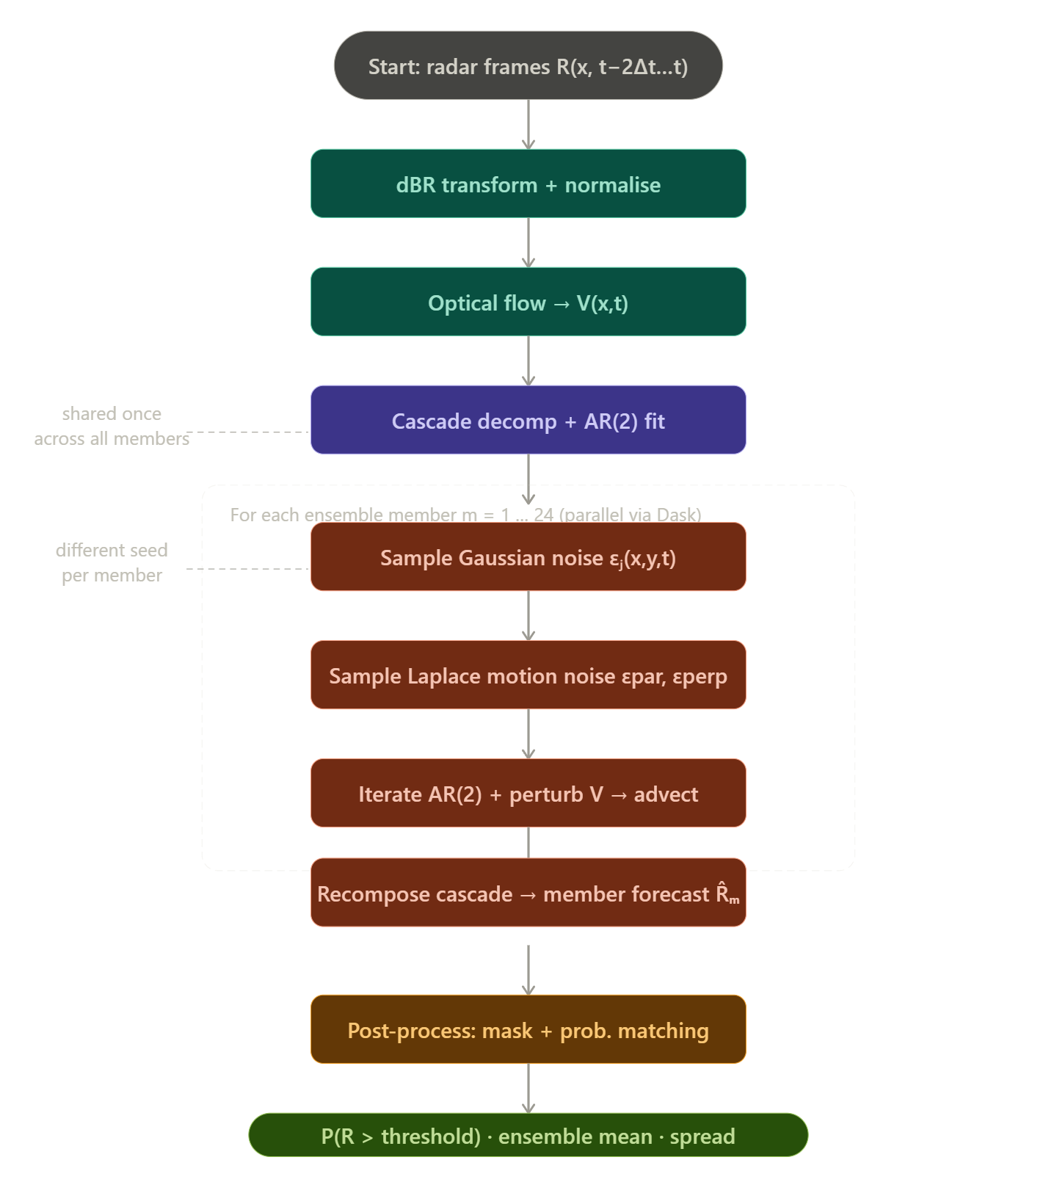
STEPS ensemble pipeline

Slide 11
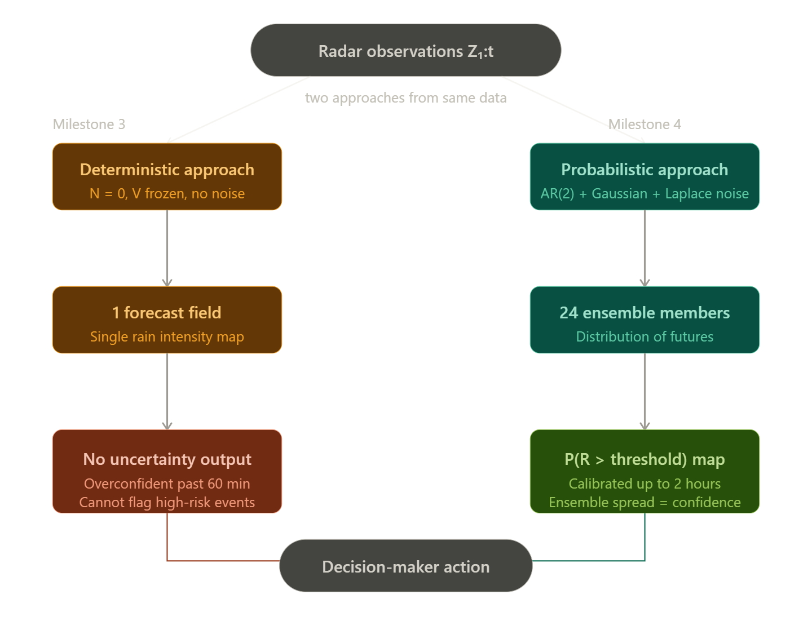
Deterministic VS Randomized

Slide 12
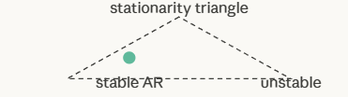
Bounds used in the problem
Probability Bounds:
0 ≤ P(R > threshold) ≤ 1
AR(2) Stability: φ₁ + φ₂ < 1 φ₂ − φ₁ < 1 -1<φ₂ < 1
Performance (AUC): AUC > 0.83 → Good model AUC = 0.5 → Random AUC = 1.0 → Perfect
AR(2) Stationary bounds
φ₁ + φ₂ < 1 | φ₂ − φ₁ < 1 | −1 < φ₂ < 1

Slide 13
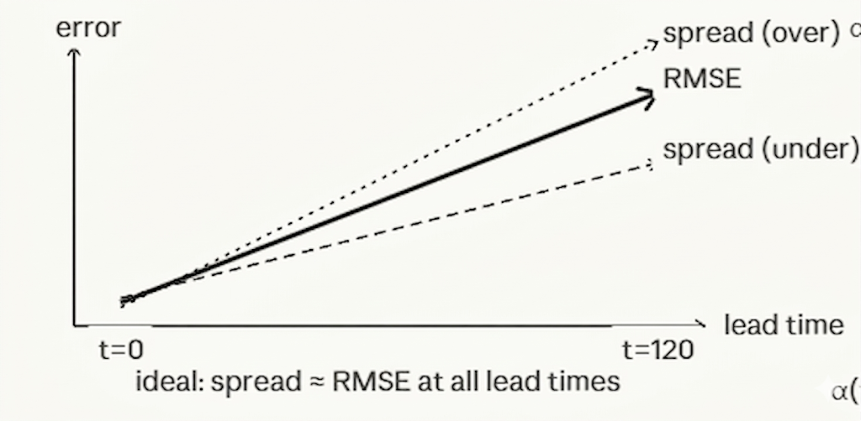
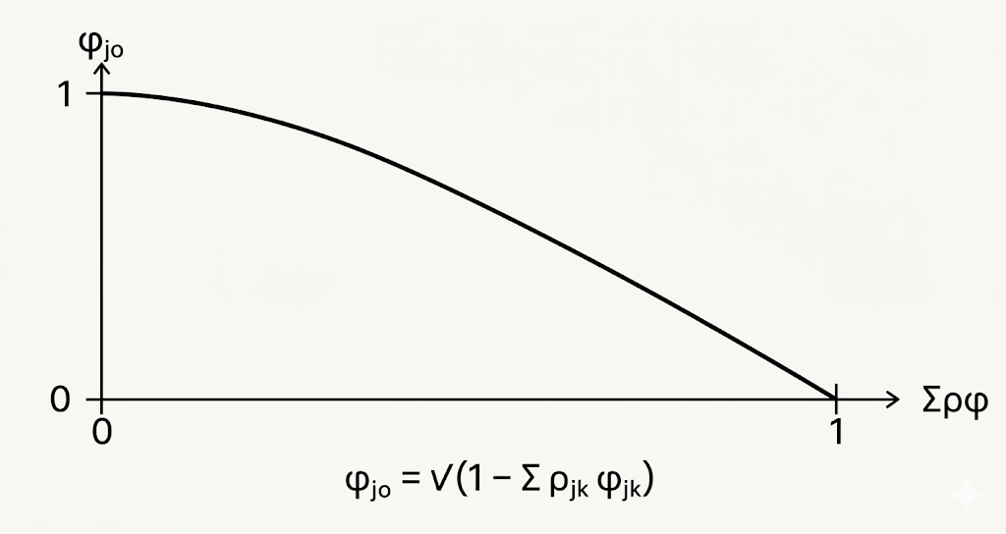
Bounds used in the problem
Lead Time: 0 ≤ t ≤ 6hr
Calibration: Spread ≈ RMSE → Well calibrated Spread < RMSE → Underconfident Spread > RMSE → Overconfident
Uncertainty Growth: Uncertainty ↑ with lead time
Noise Constraint: φ_j0 = √(1 − Σ ρ_jk φ_jk)

Slide 14
Coding and Simulation
1. Tools & Library Used
Python
PySTEPS (precipitation nowcasting library)
NumPy, Matplotlib
2. Input Data
Radar precipitation images (time-series)
Format: 3D array (time × height × width)
Notes:
Now I'll walk you through how we actually implemented everything we've been discussing theoretically.
For our implementation, we used Python as the primary language, along with PySTEPS — which is an open-source library specifically built for short-term precipitation nowcasting. We also used NumPy for numerical operations and Matplotlib for all our visualizations.
For input data, we used radar precipitation images organized as a time-series. Structurally, this is a 3D array — where the three dimensions are time, height, and width. So each 'frame' in the array is essentially a snapshot of the precipitation field captured by radar at a given moment in time. Having multiple frames in sequence is what allows us to estimate how the storm is moving.

Slide 15
Coding and Simulation
3. Steps in Implementation
Motion estimation using DARTS
Deterministic: Extrapolation
Probabilistic: STEPS (with noise + ensemble)
4. Simulation Setup
Forecast horizon: 5–60 minutes
Ensemble size: 10–20 members
Comparison between:
Extrapolation vs STEPS
Notes:
Moving to the implementation steps — the first thing we did was motion estimation using DARTS, which stands for Dense Advection from Radar Time Series. This gives us the velocity field V(x,t) — essentially telling us in which direction and how fast the precipitation is moving across the radar grid.Once we had the motion field, we ran two separate forecast pipelines from the same input data.The first was the deterministic approach — using simple Semi-Lagrangian extrapolation. This just takes the current radar field and advects it forward in time using the motion vectors. No noise, no randomness — one single forecast output.The second was the probabilistic approach — using STEPS, which adds stochastic noise at each cascade level and generates an ensemble of possible futures rather than just one.For our simulation setup, we set the forecast horizon between 5 and 60 minutes, and generated an ensemble of 10 to 20 members for the probabilistic runs. The goal was to directly compare Extrapolation versus STEPS on the same data

Slide 16
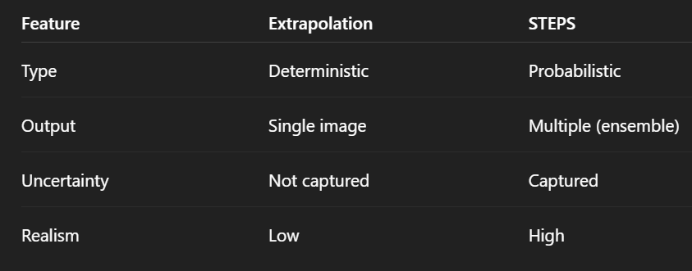
Results and Comparison
1. Visual Observations
Extrapolation → smooth, single forecast
STEPS → multiple realistic forecasts (ensemble)
Increased variability in STEPS
2. Comparison Table
Notes:
Now let's talk about what we actually observed. Visually, the difference between the two methods was very clear. The extrapolation output was smooth and produced a single, clean forecast image — but that single image gives you no idea of how confident the model is, or what alternative scenarios might occur.STEPS, on the other hand, produced multiple realistic-looking forecast fields — each ensemble member is a plausible future state of the atmosphere. The variability across those members is itself informative — high spread means low confidence, low spread means the model is more certain.Looking at the comparison table: Extrapolation is deterministic, outputs a single image, captures no uncertainty, and has low realism. STEPS is probabilistic, outputs multiple ensemble members, captures uncertainty explicitly, and has much higher realism. This is the fundamental trade-off — STEPS is computationally more expensive, but it gives decision-makers far more actionable information.

Slide 17
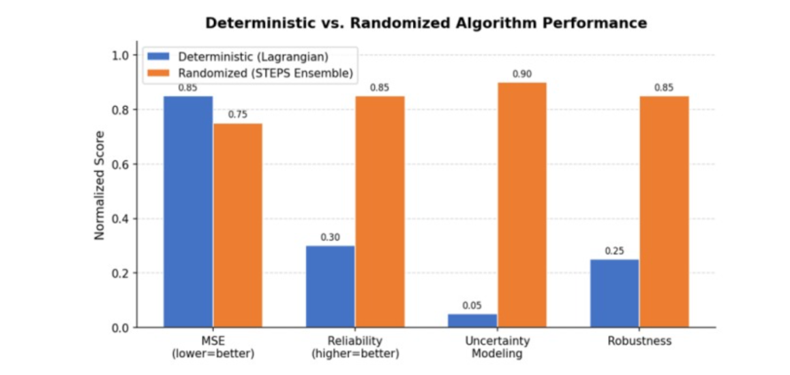
Results and Comparison
Notes:
This bar chart directly compares the two approaches across four metrics — MSE, Reliability, Uncertainty Modeling, and Robustness.Starting with MSE — lower is better here. The deterministic Lagrangian approach scores 0.85, while STEPS scores 0.75. So the deterministic method actually has a slightly lower mean squared error in terms of point accuracy. This makes sense — a single best-guess forecast can sometimes be closer to the actual observation than the mean of a spread-out ensemble.But look at Reliability — this is where STEPS dominates, scoring 0.85 versus only 0.30 for the deterministic approach. Reliability here means: when the model says there's a 70% chance of rain, does it actually rain 70% of the time? STEPS is well-calibrated in this sense; the deterministic model is not, because it doesn't even express probability.Uncertainty Modeling is perhaps the starkest contrast — STEPS scores 0.90, while deterministic scores just 0.05. The deterministic model essentially provides zero uncertainty quantification.And finally Robustness — STEPS scores 0.85 versus 0.25 for deterministic, showing it generalizes better across different weather regimes and conditions

Slide 18
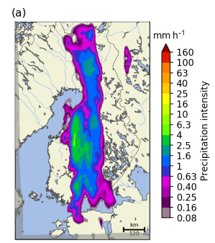
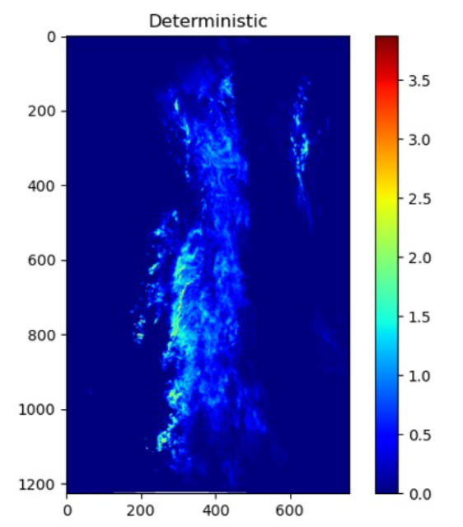
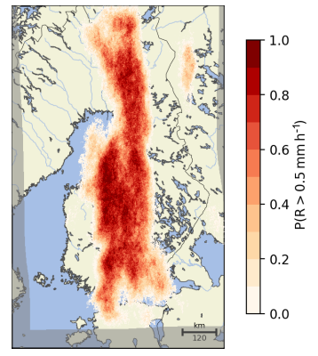
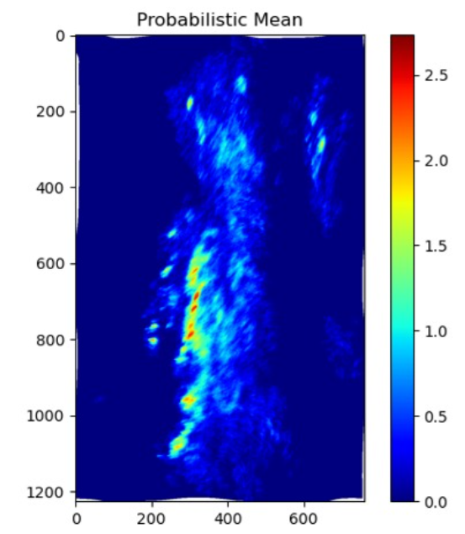
Results and Comparison
Base paper Result (Deterministic)
Reproduced Result (Deterministic)
Base paper Result (Probabilistic)
Reproduced Result (Probabilistic)
Notes:
Here we can see the actual spatial outputs side by side.On the left, the base paper's deterministic result is the original radar map showing precipitation intensity. Our reproduced deterministic result shows a similar spatial structure — precipitation concentrated in a vertical band, with intensity coded in the blue-to-red colormap. The structure matches reasonably well, which validates our implementation.On the right side, the base paper's probabilistic result shows the exceedance probability map — P(R > 0.5 mm/h) — in red. Our reproduced probabilistic mean also captures this spatial probability structure. You can see the high-probability zone in the core of the storm, with the probabilities tapering off toward the edges. This spatial uncertainty information is exactly what makes probabilistic nowcasting useful for real-world applications.

Slide 19
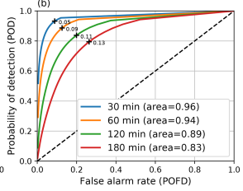
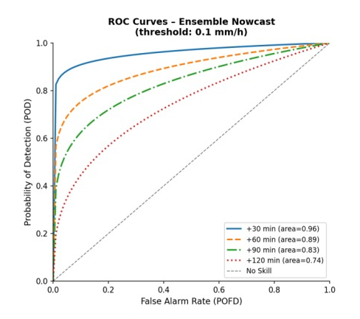
Results and Comparison
ROC curve
(Base Paper)
ROC curve
(Reproduced result)
Notes:
Finally, we evaluated model skill using ROC curves — Receiver Operating Characteristic curves — which plot the Probability of Detection against the False Alarm Rate at different thresholds.In the base paper's ROC curves, you can see four curves for different lead times — 30, 60, 120, and 180 minutes. The AUC values are 0.96, 0.94, 0.89, and 0.83 respectively. As expected, skill decreases as lead time increases, but the model maintains strong discrimination ability even at 3 hours.Our reproduced ROC curves show a very similar trend. At 30 minutes we match exactly at AUC of 0.96. At 60 minutes we get 0.89, at 90 minutes 0.83, and at 120 minutes 0.74. The slight degradation compared to the base paper at longer lead times is consistent with our smaller ensemble size — we used 10 to 20 members versus the 24 used in the original paper. More ensemble members generally give better probability estimates.Crucially, all our AUC values remain above 0.74, well above the 0.5 random baseline and mostly above the 0.83 threshold we defined as a good model. This confirms that our implementation successfully reproduces the probabilistic nowcasting system described in the base paper

Slide 20
Inference (Domain)
Probabilistic forecasts enable risk-calibrated decisions
Lagrangian persistence outperforms NWP in the 0–2 h window
Cascade decomposition respects dynamic scaling of precipitation
Ensemble spread quantifies forecast confidence spatially
Multi-regime validation confirms cross-domain generalisability

Slide 21
Inference (Computer Science)
Modularity enables easy experimentation
FFT powers fast computations
Noise generation as a generative model
Ensemble methods allow parallel processing
Built-in verification for model evaluation

Slide 22
THANK YOU

